Slide 1
Software Engineering
Members:
Akin Bin Mostofa Kamal (193-15-13394)

Slide 2
Scenario
My scenario is like the hotel management system. The customer check in to the hotel. The customer has ID, name, cellphone, address, and room number. Customers can also check out, pay bills and order food items. Receptionist book room for customer after checking room availability. The receptionist has an ID, name cellphone, and address. Every room has room no. and location. The manager has a name, ID, cellphone, and location. The manager manages hotel staff and purchases inventory. Every inventory item has a type, status, and quantity. At the time of ordering food, the customer chooses food items from the menu and places a food order. Every food order has an ID, name, and price. Chef accepts orders from customers and he has ID, name, and location. When the food is ready, it is sent to the customer via House Keeping Staff who has ID, name, and location. House Keeping staff also cleans the room. At the time of checking out, the receptionist generates bills for customers. Every bill has bill no., customer name, and amount. Customers can make complaints or give feedback about the hotel services to the Manager.

Slide 3
Functional Requirements
Functional requirements:
Check In To Hotel
Book Room
Choose Food Item
Accept Orders
Clean Room
Generate Bill
Make Complaint
Pay Amount

Slide 4
Non-Functional Requirements
Non-Functional requirements:
Security
Performance
Availability
Efficiency
Clean Room
Maintainability

Slide 5
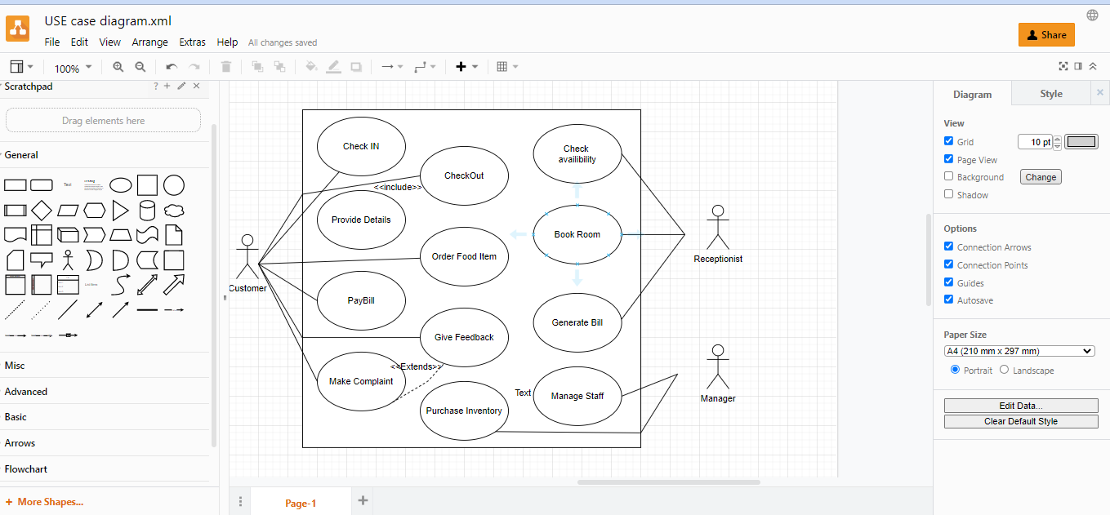
USE Case Diagram

Slide 6
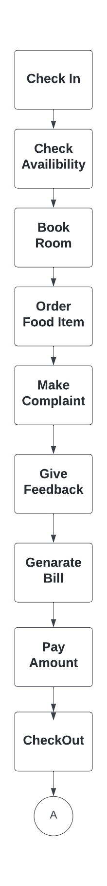
Activity Diagram

Slide 7
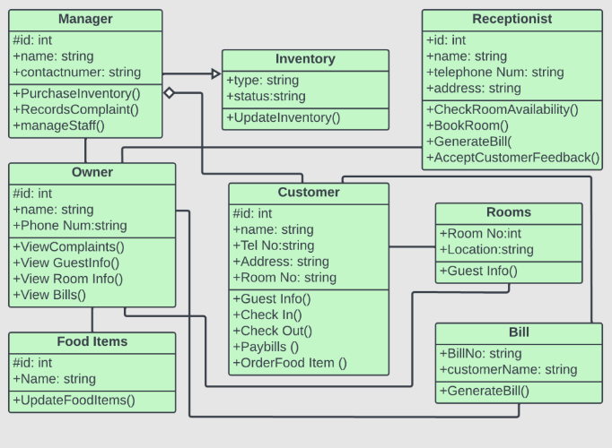
Class Diagram

Slide 8
Thank You Samia Mam

